Slide 1
comp1206 Topic 3 Control Flow JVM, Recursion, Static / Final, Exceptions, Threads
Andy Gravell
March 2020

Slide 2
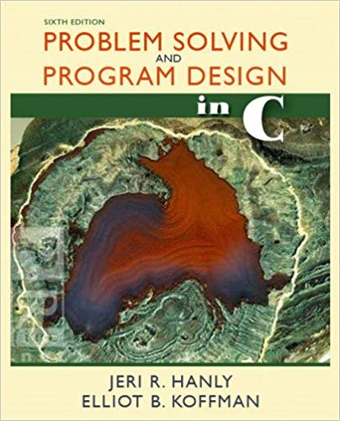
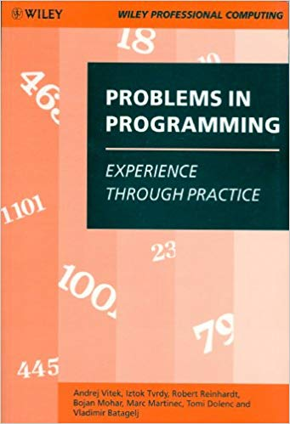
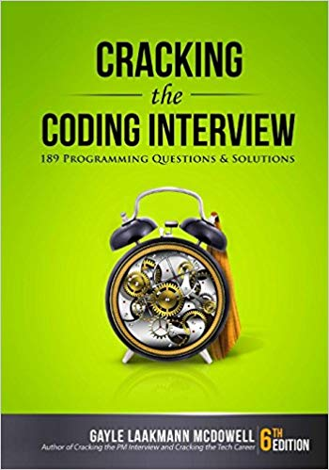
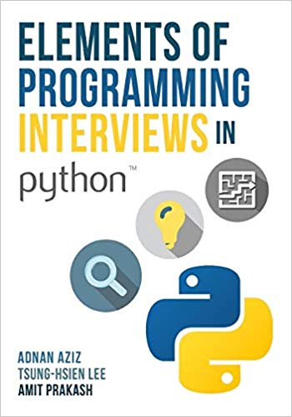
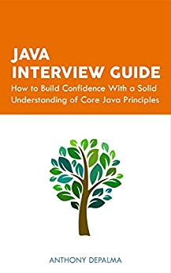
Novice | Competent | Professional | Expert | Guru
comp1206 aims to increase your coding confidence and competence
many of you will be looking for work as a professional programmer
you need to reach that level of skill, at least
and be prepared for challenging job interviews

Slide 3
Skills you need for the job interview
Knowledge of the language, for example, a multiple choice test
Knowledge of data structures and algorithms
solving programming problems, perhaps interactively at the whiteboard
Understanding of key concepts in programming, such as
Object Oriented Programming
The Object Superclass
Composition and Inheritance
Abstract Classes and Interfaces
Generics
Java Virtual Machine
Exceptions
Design Patterns
Concurrency
Memory Management
Java Database Connectivity
Java Collections Framework
Streams, Java Date Class
Unit Testing

Slide 4
Test Questions
I have provided 50 test questions for you to practice on
true/false statements to test your knowledge and understanding of the JVM
These are available via Blackboard
you have 15 minutes to complete the test
and can repeat this as often as you like
Please give me your feedback
are the questions useful, are 50 of these too many, is 15 minutes about right?
As well as job interviews, practice tests help you prepare for the exam
the exam will have ~30 mainly multiple choice/response questions
and is worth 40% of the module’s assessment

Slide 5
The Java Virtual Machine
Java promises you can write once, run anywhere (WORA)
Java is a platform as well as a language
The JVM helps to ensure this promised of portability is achieved
it is a specification, with conformance tests and reference implementation
It is a virtual machine not a physical one
java processors have been implemented but not successfully commercialised
The JVM is typically implemented in software
either using a Java bytecode interpreter, or else
a further compilation stage translating the bytecode into native instructions
for example a JIT (just in time) compiler, also known as a run-time compiler

Slide 6
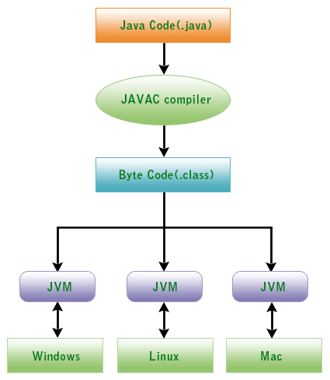
Java Portability
by Byte Code and JVM
Image from: www.devmanuals.com

Slide 7
The Java Bytecode
The virtual machine has a virtual instruction set
Each operation code is one byte long
so the compiled Java code is known as bytecode
of the 256 possible bytecodes, over 200 are allocated
too many to remember all of them!
Addresses in the JVM are 32 bits, giving 4GB addressable memory
values of type int are also 32 bits, whereas long and double are 64-bit values
A compiled class file contains the compiler-generated instructions
you can view its bytecode using the javap command

Slide 8
Javap: class file disassembler
javap -c helloworld.class
Compiled from "helloworld.java"
public class helloworld {
public helloworld();
Code:
0: aload_0
1: invokespecial #1 // Method java/lang/Object."<init>": …
4: return
public static void main(java.lang.String[]);
Code:
0: getstatic #7 // Field java/lang/System.out:Ljava/io/PrintStream;
3: ldc #13 // String Hello, World
5: invokevirtual #15 // Method java/io/PrintStream.println: …
8: return
}

Slide 9
Stacks and the Heap
Many JVM items are shared by all running code
class definitions including method tables and the bytecode itself
constant pools including string literals
objects stored in the heap – which can change, unlike the items listed above
Other items are accessible by only one thread, hence are non-shared
the stack is made up of stack frames, each containing, for example
return address, a pointer to the bytecode instruction following the method call
a reference to the this object, where applicable
method parameters (the value for a primitive type, eg int, or an object reference)
local variables (as above)
storage space for the stack based calculations

Slide 10
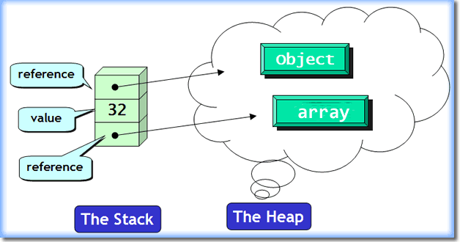
One of these per thread
but only one heap
image from: javarevisited.blogspot.com

Slide 11
Stack and Heap Lifecycles
Items are pushed onto the stack, and later popped off
so stack based storage relies on last in first out allocation and de-allocation
Heaps are used when memory de-allocation is not LIFO
space for an object can be re-used when it is no longer needed / referenced
however, free space may occur anywhere through the heap
the heap may need to be compacted to consolidate this free space
various strategies are possible for garbage collection
the best solution varies depending on the application characteristics, eg real-time
eventually, long-lived objects collect together at one end of the heap
and may then be treated as permanent, speeding up future garbage collection phases

Slide 12
Method Calls
A method call is implemented by the following sequence of steps
resolve the symbolic reference and locate its bytecode in the shared area
create a stack frame with slots for this, each argument, local method variables
each slot will contain an object reference, or a primitive value, depending on its type
although static methods do not have a reference to this
the frame includes the return address, and a reference to the class definition
finally the frame has space for the operand stack
arithmetic and logical operations use this space as the JVM has no calculation registers
the frame is pushed into the JVM stack on invocation, and popped on return
Each Java thread has its own JVM stack

